Slide 1
Attributing Fake Images to GANs: Learning and Analyzing GAN Fingerprints
Alessio Parmeggiani-Fulvio Sanguigni

Slide 2
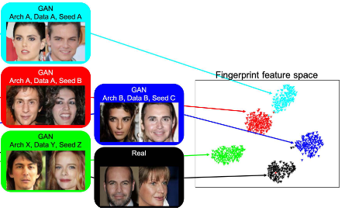
Identify GAN Fingerprints: why and how
Privacy and attribution problems
Human inspection impossible nowadays
Identify key GAN parameters for image attribution

Slide 3
Dataset and Models
Dataset
Models
We created a dataset by generating 5000 images for each GAN: CramerGAN,MMDGAN, PROGAN, SNGAN.
We used the CelebA dataset to extract 5000 real images.
In the end we tested the performance of the best model on a bigger dataset composed of 20000 images per GAN and another dataset composed by 30000 images generated by ProGAN with different seeds.
We train 4 different CNN models. This is due to the difficulty of finding the key parameters to attribute every image, so we must extract them in 4 different ways which we are going to discuss.

Slide 4
Metrics
Accuracy
macro f1
f1 (for the single class of GANs)

Slide 5
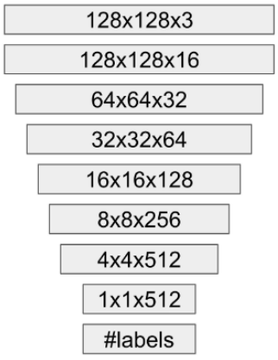
Model A
This model is a standard convolutional neural network. We tested two alternative architectures: 1x1 kernels with strides to reduce dimension, or 3x3 kernels with average pooling to reduce image dimension. The latter had the best performance, so we kept this architecture. We trained this model adding two dropout layers to avoid overfitting.

Slide 6
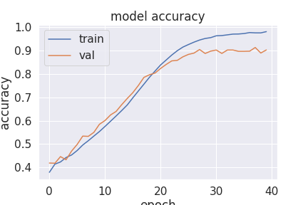
Results
The model was very good at the first trial, on a sub-dataset with 5000 images per GAN without real images. The train accuracy was 0,9649. To reduce its excessive overfitting, we equipped the CNN with two dropout layers. The first after the third hidden layer, the second after the last convolutional layer. The train accuracy dropped a bit to 0,9432, but with a solid test accuracy of 0,9350. Then, we added the real images, obtaining a training accuracy of 0,9811, with a bit of overfit.
epoch

Slide 7
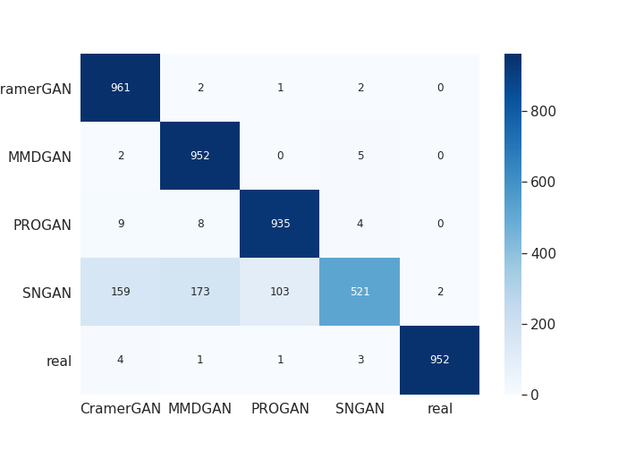
results: classification report and confusion matrix
Accuracy | Precision | recall | F1
90.0 | 91.1 | 90.0 | 90.4

Slide 8
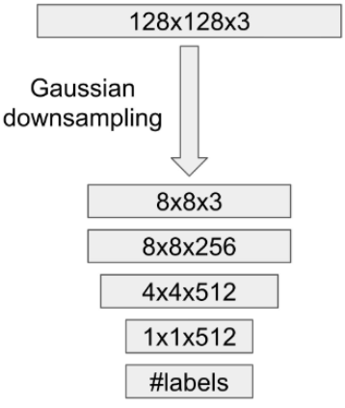
Model B
This model has the same structure of the previous one, except that it receives images downsampled to 8x8. This allows us to attribute fingerprints from a different frequency band.

Slide 9
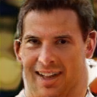

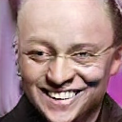

Downsampling
PROGAN
SNGAN
Downsampling
Downsampling
128x128
8x8
128x128
8x8

Slide 10
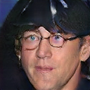
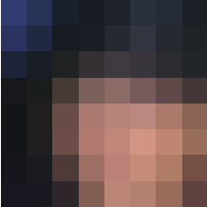
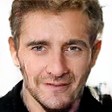

Downsampling
MMDGAN
CramerGAN
Downsampling
128x128
8x8
Downsampling
128x128
8x8

Slide 11
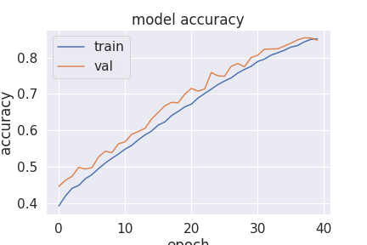
Results
It was necessary to add a batch normalization layer to boost its the accuracy, and then two dropouts layers and an L2 regularization helped to control overfitting. Then, we finally tested it with a lower train accuracy (0.8509) but without overfitting
epoch

Slide 12
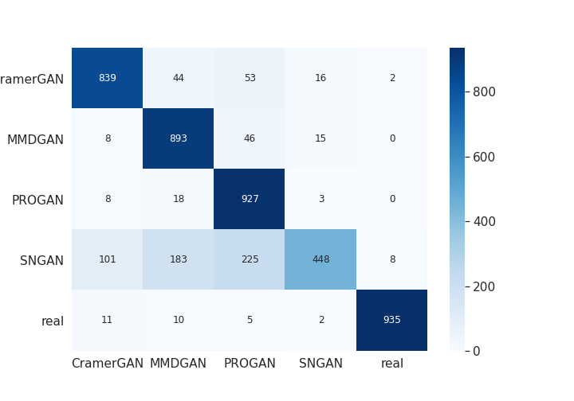
results: classification report and confusion matrix
Accuracy | Precision | recall | F1
84.2 | 86.0 | 84.3 | 85.1

Slide 13
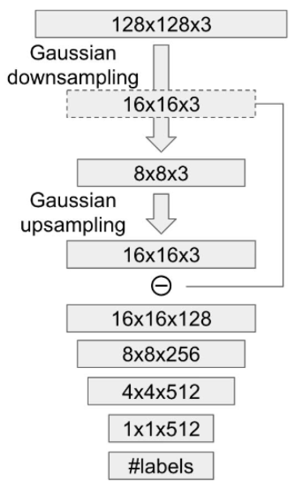
Model C
This model is complementary to the model B, and extract high frequency features using an approach similar to the laplacian pyramid, it subtracts an upscaled version of the low resolution image from the base version and then use the results as the input of the fully convolutional layer.
The resulting image will highlight edges, changes of colour,sharp details and other high frequency information.

Slide 14
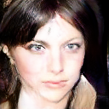
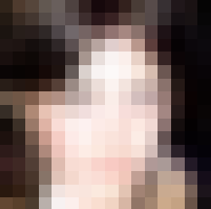
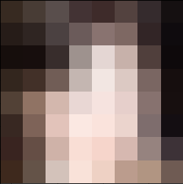

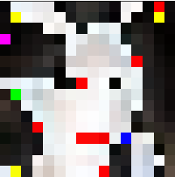
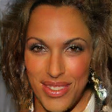
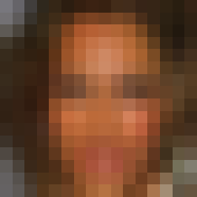
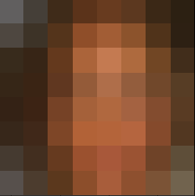

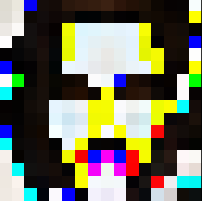
Model C preprocessing
CramerGAN
128x128
Downsampling
16x16
Downsampling
8x8
Upsampling
16x16
16x16
SNGAN
128x128
Downsampling
16x16
Downsampling
8x8
Upsampling
16x16
16x16

Slide 15
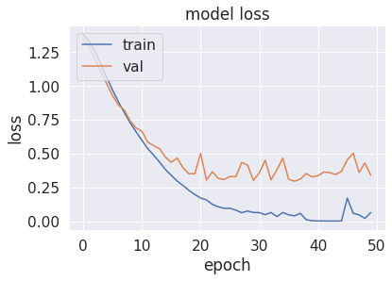
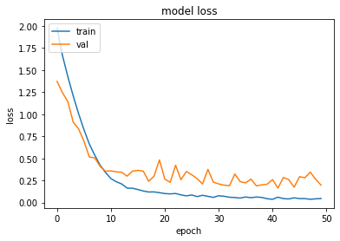
Results
The model obtained good results even with no hyperparameter tuning and it reached an accuracy of 93% on the validation set with some overfitting.
By adding dropout before the final dense layer and weight decaying on the convolutional layer the overfitting reduced but the performances were slightly worse even with more epochs of training
The best results were obtained using batch normalization after every convolutional layer and it increased the results to 95% of overall accuracy.
Loss plot of the original model showing some overfitting.
loss plot after dropout and batch normalization.

Slide 16
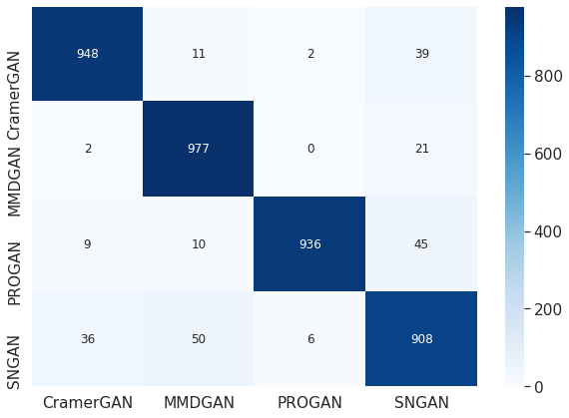
Results
The evaluation on the test set showed good results on the first three GANs but some problems on the classification of the images belonging to the SNGAN class.
Accuracy | Macro Precision | Macro recall | Macro F1
95 | 95.2 | 95 | 94.8
Cramer | MMD | PROGAN | SN
96.8 | 96.2 | 96.7 | 89.5

Slide 17
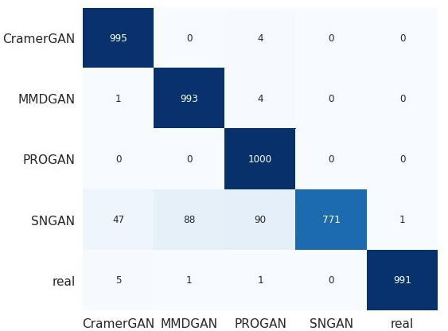
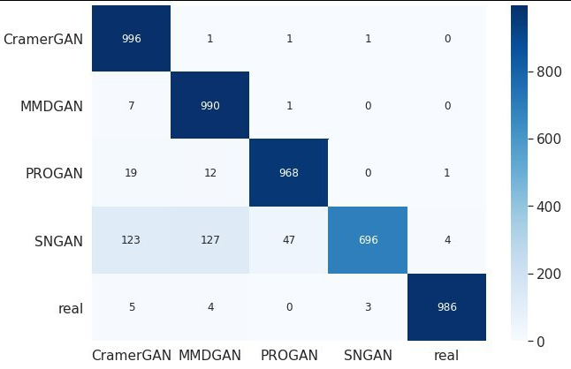
Adding the real label
We trained the model also on the dataset that contains the real images and found out that it’s really good in the classification of the real images but it’s really unstable on the other classes, in particular the SNGAN class.
The results from the same model and with one epoch of training of difference

Slide 18
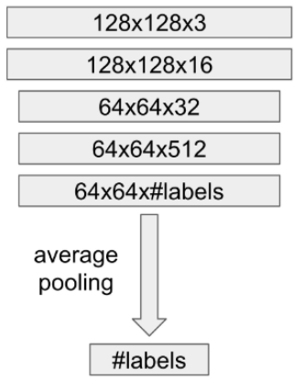
Model D
With this model we test if fingerprints of a GAN can be derived from a patch of the input.
The network is composed of a fully convolutional network and the output is then downsampled into a single value using average pooling.

Slide 19
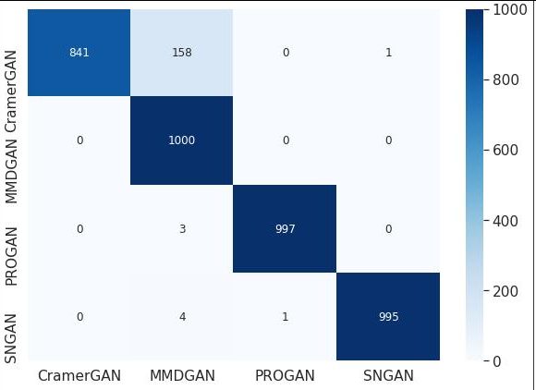
Results
The results from the evaluation on the model D showed that the model performs really well on the classes on which the model C had more difficulties.
Accuracy | Precision | recall | F1
95.8 | 96.4 | 95.8 | 95.1
Cramer | MMD | PROGAN | SN
91.4 | 92.4 | 99.8 | 99.7

Slide 20
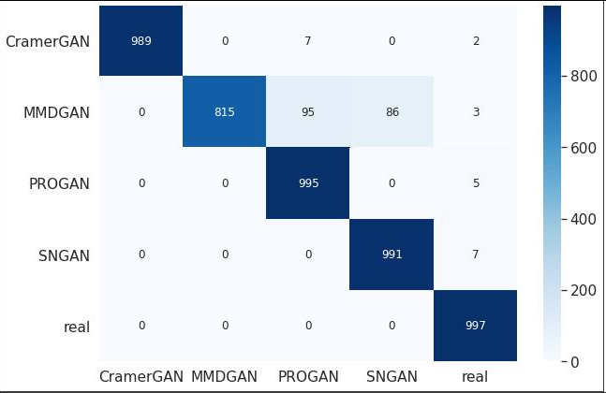
Adding real label
After a retraining on the new dataset with added the real images the model still performs well on the GAN labels and obtains good results on the real images.
In particular it score a precision of 98 and a recall of 100, this means that classify correctly every real image and only a few times it classify GAN images as real.

Slide 21
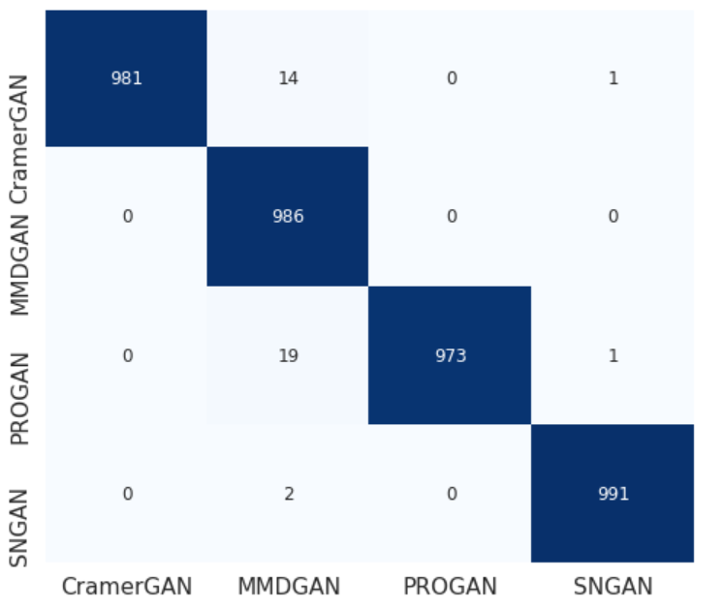
Using a bigger dataset
We tried also to train the best model (model D) on a bigger dataset composed of 20000 images per class, in order to obtain better results and more similar to the one of the paper that used 100000 images for each GAN.
We decided to not include the real images because the previous model already obtained almost perfect performances on that class.
With a total of 80000 images the model reached as expected better results than the previous model and improved on every class.
CramerGan | MMDGAN | ProGAN | SNGAN
99.2 | 98.3 | 99 | 99.8
Results after only 15 epochs of training.

Slide 22
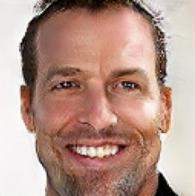

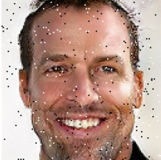

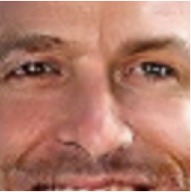
Perturbation attacks
Following the paper we tested how much the model is robust to perturbation attacks.
Original
Relighting
Noise
Blur
Cropping
 | Original | Relighting | Noise | Blur | Cropping
Accuracy | 95.8 | 85.4 | 94 | 60 | 94
Results using model D and 30 epochs of training.

Slide 23
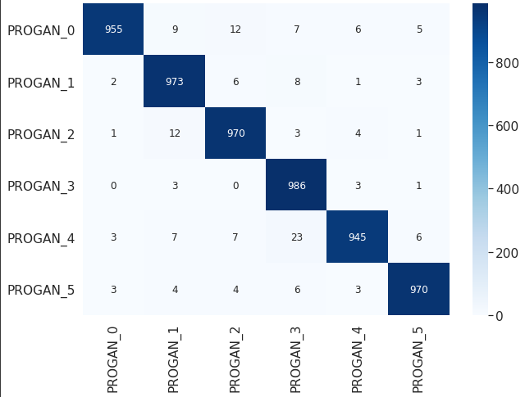
Classification using different initialization seed
We trained the model also on a dataset composed of 6 classes with 5000 images generated by ProGAN and a different seed, to show if is the initialization seed and so the different type of randomness that create the fingerprint that is attributed to a specific type of GAN.
This time, model D could not learn to correctly classify images and didn’t surpass the performances of a random baseline.
We tested also model C using this dataset and it outperformed the previous model.

Slide 24
Conclusions
We found out that the model that performed generally better was model D.
This highlight how for each image a patch of size 64x64 carries enough information about the fingerprint of the GAN to correctly classify it among the other GANs but it’s not enough to distinguish between the same GAN with different seeds.
For this last task is necessary a more detailed analysis on the high frequency information of an image and is more suited the model C.

